Slide 1
Speed Control of a DC Motor

Slide 2
What is back emf?
When a current carrying conductor rotated in a magnetic filed, then a voltage will be developed across it. The main function of this induced voltage is to oppose the supply voltage. This induced voltage is known as Back emf.
This voltage always less than the supply voltage.
If this induced voltage is equal to the supply voltage, then the motor will stop.

Slide 3
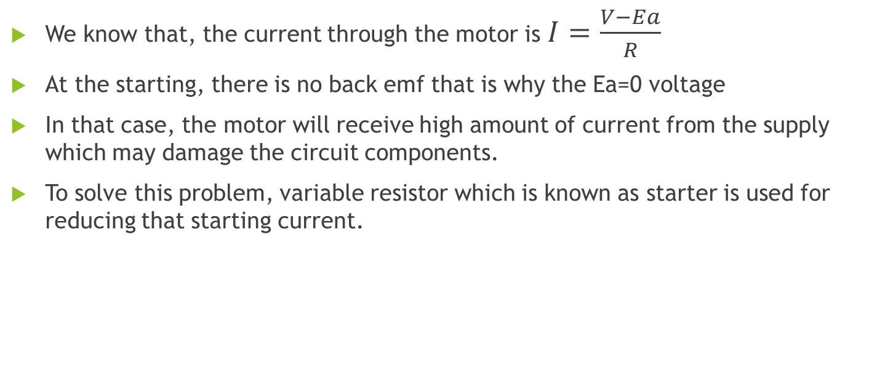
Necessary of Starter
We know that, the current through the motor is $I=\frac{V−Ea}{R}$
At the starting, there is no back emf that is why the Ea=0 voltage
In that case, the motor will receive high amount of current from the supply which may damage the circuit components.
To solve this problem, variable resistor which is known as starter is used for reducing that starting current.

Slide 4
Speed of the Motor:
We know that the speed of the motor can be calculated as
Ea=KøS
Where, Ea= back emf, ø= magnetic flux, S=speed
Hence, S=Ea/kø
If the field circuit is opened at the running condition, then the ø will be zero.
In that case we can get infinite speed which may damage the motor winding.

Slide 5
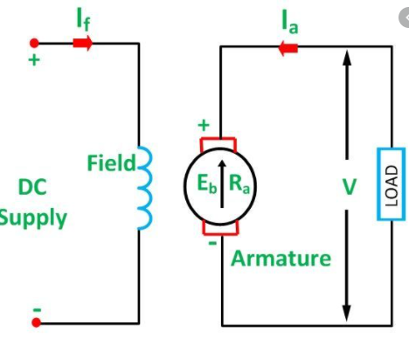
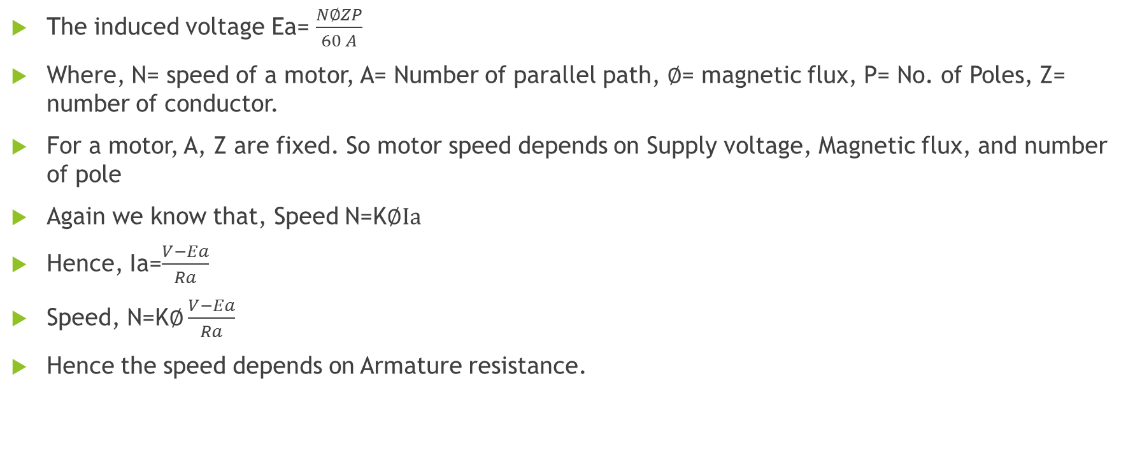
Speed of a Motor
The induced voltage Ea= $\frac{N∅ZP}{60 A}$
Where, N= speed of a motor, A= Number of parallel path, $∅$= magnetic flux, P= No. of Poles, Z= number of conductor.
For a motor, A, Z are fixed. So motor speed depends on Supply voltage, Magnetic flux, and number of pole
Again we know that, Speed N=K$∅Ia$
Hence, Ia=$\frac{V−Ea}{Ra}$
Speed, N=K$∅\frac{V−Ea}{Ra}$
Hence the speed depends on Armature resistance.

Slide 6
Math Problem
A 250 V shunt motor with armature resistance of 0.5 ohm runs at 600 rpm on full load and takes an armature current of 20 A. If resistant of 1 ohm is placed in the armature circuit, find the speed at full load and half load torque.

Slide 7
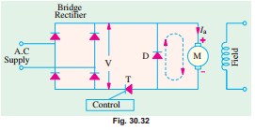
Speed Control of DC Motor Using Thyristor
Hence, the speed of a motor depends on the supply voltage. If we increase or decrease the supply voltage, the speed of a motor will be changed.
Again we can increase or decrease the supply voltage by controlling the firing angle of a thyristor.
If firing angle increases, V decreases and hence N decreases. Conversely, as a decreases, V increases and so, N increases.
When thyristor is turned off, the storage energy of inductor is dissipated in the diode which is shown in the dotted link.

